Slide 1
Building Database Applications with JDBC

Slide 2

Objectives
After completing this lesson, you should be able to:
  Define the layout of the JDBC API
  Connect to a database by using a JDBC driver
  Submit queries and get results from the database
  Specify JDBC driver information externally
Notes:
Java SE 7 Programming 14 - <number>

Slide 3
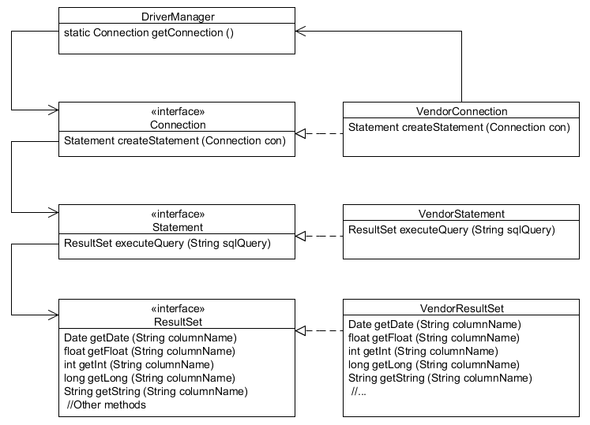
Using the JDBC API
1
2
3
Notes:
The JDBC API is made up of some concrete classes, such as Date, Time, and SQLException, and a set of interfaces that are implemented in a driver class that is provided by the database vendor.
Because the implementation is a valid instance of the interface method signature, once the database vendor’s Driver classes are loaded, you can access them by following the sequence shown in the slide:
1. Use the class DriverManager to obtain a reference to a Connection object using the getConnection method . The typical signature of this method is getConnection (url, name, password), where url is the JDBC URL, and name and password are strings that the database will accept for a connection.
2. Use the Connection object (implemented by some class that the vendor provided) to obtain a reference to a Statement object through the createStatement method. The typical signature for this method is createStatement () with no arguments.
3. Use the Statement object to obtain an instance of a ResultSet through an executeQuery (query) method. This method typically accepts a string (query) where query is a static string SQL.
Java SE 7 Programming 14 - <number>

Slide 4
Using a Vendor’s Driver Class
The DriverManager class is used to get an instance of a Connection object, using the JDBC driver named in the JDBC URL:
String url = "jdbc:derby://localhost:1527/EmployeeDB";
Connection con = DriverManager.getConnection (url);
  The URL syntax for a JDBC driver is:
jdbc:<driver>:[subsubprotocol:][databaseName][;attribute=value]
  Each vendor can implement its own subprotocol.
  The URL syntax for an Oracle Thin driver is:
jdbc:oracle:thin:@//[HOST][:PORT]/SERVICE
    Example:
jdbc:oracle:thin:@//myhost:1521/orcl
Notes:
DriverManager
Any JDBC 4.0 drivers that are found in the class path are automatically loaded. The DriverManager.getConnection method will attempt to load the driver class by looking at the file META_INF/services/java.sql.Driver. This file contains the name of the JDBC driver’s implementation of java.sql.Driver. For example, the contents of META-INF/services/java.sql.driver file in the derbyclient.jar contains org.apache.derby.jdbc.ClientDriver.
Drivers prior to JDBC 4.0 must be loaded manually by using:
try {
java.lang.Class.forName("<fully qualified path of the driver>");
} catch (ClassNotfoundException c) {
}
Driver classes can also be passed to the interpreter on the command line:
java –djdbc.drivers=<fully qualified path to the driver> <class to run>
Java SE 7 Programming 14 - <number>

Slide 5
Key JDBC API Components
Each vendor’s JDBC driver class also implements the key API classes that you will use to connect to the database, execute queries, and manipulate data:
  java.sql.Connection: A connection that represents the session between your Java application and the database
    Connection con = DriverManager.getConnection(url, username, password);
  java.sql.Statement: An object used to execute a static SQL statement and return the result
    Statement stmt = con.createStatement();
  java.sql.ResultSet: A object representing a database result set
    String query = "SELECT * FROM Employee";
    ResultSet rs = stmt.executeQuery(query);
Notes:
Connections, Statements, and ResultSets
The real beauty of the JDBC API lies in the way it provides a flexible and portable way to communicate with a database.
The JDBC driver that is provided by a database vendor implements each of these Java interfaces. Your Java code can use the interface knowing that the database vendor provided the implementation of each of the methods in the interface.
Connection is an interface that provides a session with the database. While the connection object is open, you can access the database, create statements, get results, and manipulate the database. When you close a connection, the access to the database is terminated and the open connection closed.
Statement is an interface that provides a class for executing SQL statements and returning the results. The Statement interface is for static SQL queries. There are two other subinterfaces: PreparedStatement, which extends Statement and CallableStatement, which extends PreparedStatement.
ResultSet is an interface that manages the resulting data returned from a Statement.
Note: SQL commands and keywords are case-insensitive—that is, you can use SELECT, or Select. SQL table and column names (identifiers) may be case-insensitive or case-sensitive depending upon the database. SQL identifiers are case-insensitive in the Derby database (unless delimited).
Java SE 7 Programming 14 - <number>

Slide 6
Using a ResultSet Object
String query = "SELECT * FROM Employee";
ResultSet rs = stmt.executeQuery(query);
The first next() method invocation returns true, and rs points to the first row of data.
ResultSet cursor
rs.next()
110 | Troy | Hammer | 1965-03-31 | 102109.15
123 | Michael | Walton | 1986-08-25 | 93400.20
201 | Thomas | Fitzpatrick | 1961-09-22 | 75123.45
101 | Abhijit | Gopali | 1956-06-01 | 70000.00
rs.next()
rs.next()
rs.next()
rs.next()
null
The last next() method invocation returns false, and the rs instance is now null.
Notes:
ResultSet Objects
ResultSet maintains a cursor to the returned rows. The cursor is initially pointing before the first row.
The ResultSet.next() method is called to position the cursor in the next row.
The default ResultSet is not updatable and has a cursor that points only forward.
It is possible to produce ResultSet objects that are scrollable and/or updatable. The following code fragment, in which con is a valid Connection object, illustrates how to make a result set that is scrollable and insensitive to updates by others, and that is updatable:
Statement stmt
= con.createStatement(ResultSet.TYPE_SCROLL_INSENSITIVE,
ResultSet.CONCUR_UPDATABLE);
ResultSet rs = stmt.executeQuery("SELECT a, b FROM TABLE2");
Note: Not all databases support scrollable result sets.
ResultSet has accessor methods to read the contents of each column returned in a row. ResultSet has a getter method for each type.
Java SE 7 Programming 14 - <number>

Slide 7
Putting It All Together
package com.example.text;
import java.sql.DriverManager;
import java.sql.ResultSet;
import java.sql.SQLException;
import java.util.Date;
public class SimpleJDBCTest {
public static void main(String[] args) {
String url = "jdbc:derby://localhost:1527/EmployeeDB";
String username = "public";
String password = "tiger";
String query = "SELECT * FROM Employee";
try (Connection con =
DriverManager.getConnection (url, username, password);
Statement stmt = con.createStatement ();
ResultSet rs = stmt.executeQuery (query)) {
The hard-coded JDBC URL, username, and password is just for this simple example.
Notes:
In this slide and in the following slide, you see a complete example of a JDBC application, a simple one that reads all the rows from an Employee database and returns the results as strings to the console.
Line 15–16: Use a try-with-resources statement to get an instance of an object that implements the Connection interface.
Line 17: Use that object to get an instance of an object that implements the Statement interface from the Connection object.
Line 18: Create a ResultSet by executing the string query using the Statement object.
Note: Hard coding the JDBC URL, username, and password makes an application less portable. Instead, consider using java.io.Console to read the username and password and/or some type of authentication service.
Java SE 7 Programming 14 - <number>

Slide 8
Putting It All Together
Loop through all of the rows in the ResultSet.
while (rs.next()) {
int empID = rs.getInt("ID");
String first = rs.getString("FirstName");
String last = rs.getString("LastName");
Date birthDate = rs.getDate("BirthDate");
float salary = rs.getFloat("Salary");
System.out.println("Employee ID: " + empID + "\n"
+ "Employee Name: " + first + " " + last + "\n"
+ "Birth Date: " + birthDate + "\n"
+ "Salary: " + salary);
} // end of while
} catch (SQLException e) {
System.out.println("SQL Exception: " + e);
} // end of try-with-resources
}
}
Notes:
Lines 20–24: Get the results of each of the data fields in each row read from the Employee table.
Lines 25–28: Print the resulting data fields to the system console.
Line 30: SQLException: This class extends Exception thrown by the DriverManager, Statement, and ResultSet methods. (More about this exception class in the next slide.)
Line 32: This is the closing brace for the try-with-resources statement on line 15.
This example is from the SimpleJDBCExample project.
Output:
run:
Employee ID: 110
Employee Name: Troy Hammer
Birth Date: 1965-03-31
Salary: 102109.15
etc.
Java SE 7 Programming 14 - <number>

Slide 9
Writing Portable JDBC Code
The JDBC driver provides a programmatic “insulating” layer between your Java application and the database. However, you also need to consider SQL syntax and semantics when writing database applications.
  Most databases support a standard set of SQL syntax and semantics described by the American National Standards Institute (ANSI) SQL-92 Entry-level specification.
  You can programmatically check for support for this specification from your driver:
    Connection con = DriverManager.getConnection(url, username, password);
    DatabaseMetaData dbm = con.getMetaData();
    if (dbm.supportsANSI92EntrySQL()) {
    // Support for Entry-level SQL-92 standard
    }
Notes:
In general, you will probably write an application that leverages the capabilities and features of the database you are working with. However, if you want to write a portable application, you need to consider what support each database will provide for SQL types and functionality. Fortunately, you can query the database driver programmatically to determine what level of support the driver provides. The DatabaseMetaData interface has a set of methods that the driver developer uses to indicate what the driver supports, including support for the entry, intermediate, or full support for SQL-92.
The DatabaseMetaData interface also includes other methods that determine what type of support the database provides for queries, types, transactions, and more.
Java SE 7 Programming 14 - <number>

Slide 10
The SQLException Class
SQLException can be used to report details about resulting database errors. To report all the exceptions thrown, you can iterate through the SQLExceptions thrown:
catch(SQLException ex) {
while(ex != null) {
System.out.println("SQLState: " + ex.getSQLState());
System.out.println("Error Code:" + ex.getErrorCode());
System.out.println("Message: " + ex.getMessage());
Throwable t = ex.getCause();
while(t != null) {
System.out.println("Cause:" + t);
t = t.getCause();
}
ex = ex.getNextException();
}
}
Vendor-dependent state codes, error codes and messages
Notes:
A SQLException is thrown from errors that occur in one of the following types of actions: driver methods, methods that access the database, or attempts to get a connection to the database.
The SQLException class also implements Iterable. Exceptions can be chained together and returned as a single object.
SQLException is thrown if the database connection cannot be made due to incorrect username or password information or simply the database is offline.
SQLException can also result by attempting to access a column name that is not part of the SQL query.
SQLException is also subclassed, providing granularity of the actual exception thrown.
Note: SQLState and SQLErrorCode values are database dependent. For Derby, the SQLState values are defined here: http://download.oracle.com/javadb/10.8.1.2/ref/rrefexcept71493.html.
Java SE 7 Programming 14 - <number>

Slide 11
Closing JDBC Objects
One Way
Better Way
Connection
Connection
close()
close()
Closes Statements
Statement
Statement
close()
Invalidates ResultSets
Call close explicitly or
in try-with-resources
ResultSet
ResultSet
close()
Resources not
released until
next GC
Resources
released
Notes:
Closing a Connection object will automatically close any Statement objects created with this Connection.
Closing a Statement object will close and invalidate any instances of ResultSet created by the Statement object.
Resources held by the ResultSet, may not be released until garbage is collected, so it is a good practice to explicitly close ResultSet objects when they are no longer needed.
When the close() method on ResultSet is executed, external resources are released.
ResultSet objects are also implicitly closed when an associated Statement object is re-executed.
In summary, it is a good practice to explicitly close JDBC Connection, Statement and ResultSet objects when you no longer need them.
Note: A connection with the database can be an expensive operation. It is a good practice to either maintain Connection objects for as long as possible, or use a connection pool.
Java SE 7 Programming 14 - <number>

Slide 12
The try-with-resources Construct
Given the following try-with-resources statement:
try (Connection con =
DriverManager.getConnection(url, username, password);
Statement stmt = con.createStatement();
ResultSet rs = stmt.executeQuery (query)){
  The compiler checks to see that the object inside the parentheses implements java.lang.AutoCloseable.
    This interface includes one method: void close().
  The close method is automatically called at the end of the try block in the proper order (last declaration to first).
  Multiple closeable resources can be included in the try block, separated by semicolons.
Notes:
One of the JDK 7 features is the try-with-resources statement. This is an enhancement that will automatically close open resources.
With JDBC 4.1, the JDBC API classes including ResultSet, Connection, and Statement, implement java.lang.AutoCloseable. The close() method of the ResultSet, Statement, and Connection objects will be called in order in this example.
Java SE 7 Programming 14 - <number>

Slide 13
try-with-resources: Bad Practice
It might be tempting to write try-with-resources more compactly:
try (ResultSet rs = DriverManager.getConnection(url, username, password).createStatement().executeQuery(query)) {
  However, only the close method of ResultSet is called, which is not a good practice.
  Always keep in mind which resources you need to close when using try-with-resources.
Notes:
Avoid This try-with-resources Pitfall
It may appear to be a time-saving way to write these three statements, but the net effect is that the Connection returned by the DriverManager is never explicitly closed after the end of the try block, which is not a good practice.
Java SE 7 Programming 14 - <number>

Slide 14
Writing Queries and Getting Results
To execute SQL queries with JDBC, you must create a SQL query wrapper object, an instance of the Statement object.
Statement stmt = con.createStatement();
  Use the Statement instance to execute a SQL query:
ResultSet rs = stmt.executeQuery (query);
  Note that there are three Statement execute methods:
Method | Returns | Used for
executeQuery(sqlString) | ResultSet | SELECT statement
executeUpdate(sqlString) | int (rows affected) | INSERT, UPDATE, DELETE, or a DDL
execute(sqlString) | boolean (true if there was a ResultSet) | Any SQL command or commands
Notes:
A SQL statement is executed against a database using an instance of a Statement object. The Statement object is a wrapper object for a query. A Statement object is obtained through a Connection object—the database connection. So it makes sense that from a Connection, you get an object that you can use to write statements to the database.
The Statement interface provides three methods for creating SQL queries and returning a result. Which one you use depends upon the type of SQL statement you want to use:
executeQuery(sqlString): For a SELECT statement, returns a ResultSet object
executeUpdate(sqlString): For INSERT, UPDATE, and DELETE statements, returns an int (number of rows affected), or 0 when the statement is a Data Definition Language (DDL) statement, such as CREATE TABLE.
execute(sqlString): For any SQL statement, returns a boolean indicating if a ResultSet was returned. Multiple SQL statements can be executed with execute.
Java SE 7 Programming 14 - <number>

Slide 15

Practice 18-1 Overview:
Working with the Derby Database and JDBC
This practice covers the following topics:
  Starting the JavaDB (Derby) database from within NetBeans IDE
  Populating the database with data (the Employee table)
  Running SQL queries to look at the data
  Compiling and running the sample JDBC application
Notes:
In this practice, you will start the database from within NetBeans, populate the database with data, run some SQL queries, and compile and run a simple application that returns the rows of the Employee database table.
Java SE 7 Programming 14 - <number>

Slide 16
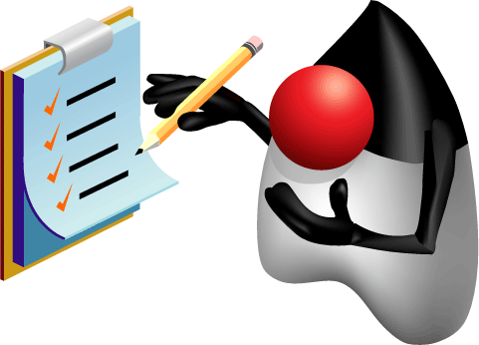
Summary
In this lesson, you should have learned how to:
  Define the layout of the JDBC API
  Connect to a database by using a JDBC driver
  Submit queries and get results from the database
  Specify JDBC driver information externally
Notes:
Java SE 7 Programming 14 - <number>

Slide 17
Quiz
Which Statement method executes a SQL statement and returns the number of rows affected?
  stmt.execute(query);
  stmt.executeUpdate(query);
  stmt.executeQuery(query);
  stmt.query(query);
Notes:
Answer: b
a: execute returns a boolean (true if there is a ResultSet. This can be used with any SQL statement).
c: executeQuery returns a ResultSet (used with a SELECT statement).
d: This is not a valid Statement method.
Java SE 7 Programming 14 - <number>

Slide 18
Quiz
When using a Statement to execute a query that returns only one record, it is not necessary to use the ResultSet's next() method.
  True
  False
Notes:
Answer: b (False)
A ResultSet’s pointer is always pointing to just before the first row, regardless of whether it is one row or multiple rows.
Java SE 7 Programming 14 - <number>

Slide 19
Quiz
The following try-with-resources statement will properly close the JDBC resources:
try (Statement stmt = con.createStatement();
ResultSet rs = stmt.executeQuery(query)){
//...
} catch (SQLException s) {
}
  True
  False
Notes:
Answer: a (True)
This illustrates a good practice: explicitly closing the ResultSet in try-with-resources.
Java SE 7 Programming 14 - <number>

Slide 20
Quiz
Given:
String[] params = {"Bob", "Smith"};
String query = "SELECT itemCount FROM Customer " +
"WHERE lastName='?' AND firstName='?'";
try (PreparedStatement pStmt = con.prepareStatement(query)) {
for (int i = 0; i < params.length; i++)
pStmt.setObject(i, params[i]);
ResultSet rs = pStmt.executeQuery();
while (rs.next()) System.out.println (rs.getInt("itemCount"));
} catch (SQLException e){ }
Assuming there is a valid Connection object and the SQL query will produce at least one row, what is the result?
  Each itemCount value for customer Bob Smith
  Compiler error
  A run time error
  A SQLException
Notes:
Answer: c
Notice on line15, the PreparedStatement setObject method is called using the array index, 0, instead of 1 for the first parameter. To fix this code, you should replace line 15 with:
pStmt.setObject(i+1, params[i]);
Java SE 7 Programming 14 - <number>

